Slide 1
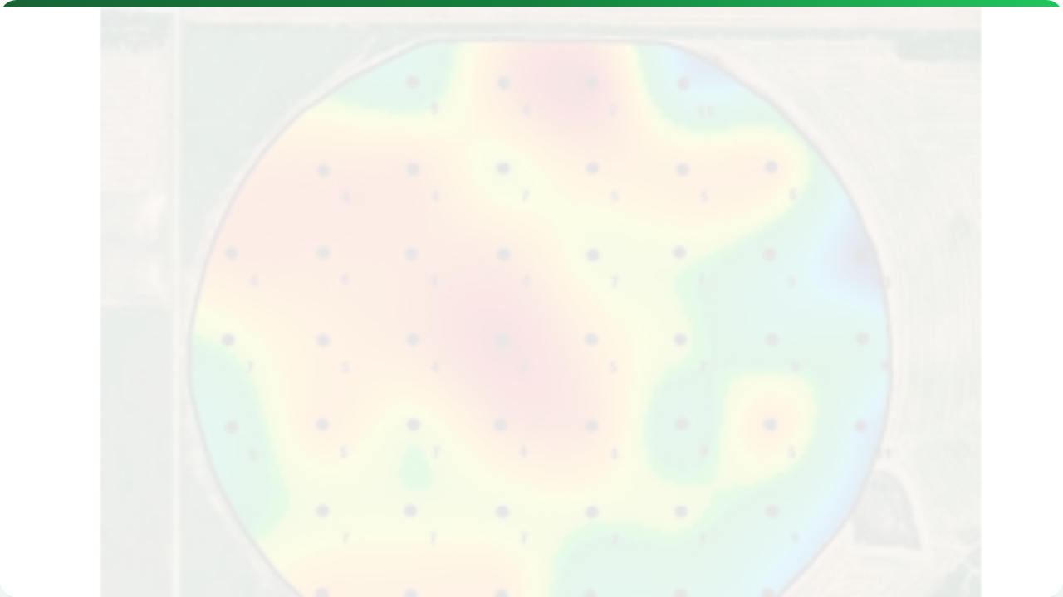



PROXIMAL SOIL SENSORS
Lecture 5: Nutrients & pH
AGE 418
Dr. Kadeghe Fue

Slide 2




Lecture Roadmap
Sampling & pH
Nutrient Sensing
The "Chemistry" Challenge
Optical (Vis-NIR)
Traditional Sampling (Grid vs Zone)
Electrochemical (ISE)
Proximal pH Sensors (Veris)
Gamma Ray Spectroscopy
Applications (VRA)

Slide 3
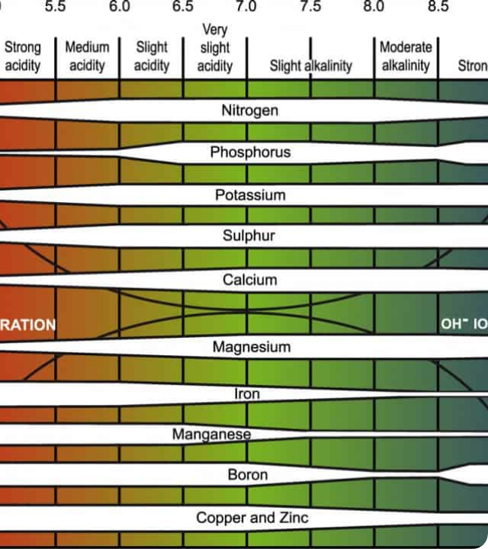
The Challenge
Physics vs. Chemistry
Lecture 4 (Physics): Moisture and Texture are physical properties. They are "easy" to measure with electricity.
Lecture 5 (Chemistry): Nutrients (N, P, K) are chemical ions. Detecting specific ions in a "noisy" soil environment is difficult and expensive.

Slide 4


The Ground Truth: Soil Sampling
Before sensors, we must understand the baseline. Physical lab analysis is still the gold standard.
Grid Sampling
Zone Sampling
Systematic, expensive.
Smart, efficient.

Slide 5

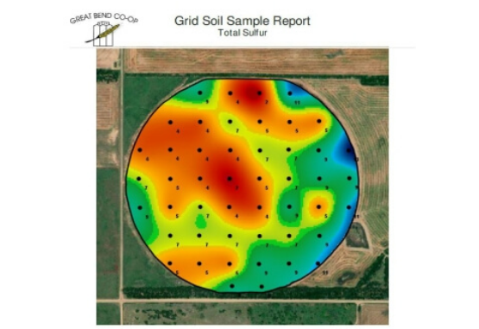
Grid Sampling
Divide the field into equal squares (e.g., 1 hectare grids).
Pros: Finds unknown variability. No prior knowledge needed.
Cons: Very expensive (lab fees). Ignores soil type boundaries.
Best For: Fields with no history.

Slide 6
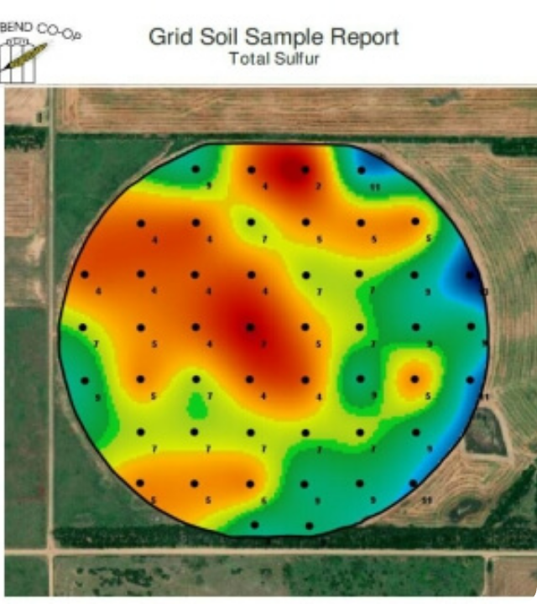
Zone Sampling
Divide field based on existing data (Yield maps, EC maps, Topography).
Pros: Cheaper (fewer samples). biologically logical.
Cons: Requires good historical data.
Best For: Established Precision Ag farms.

Slide 7
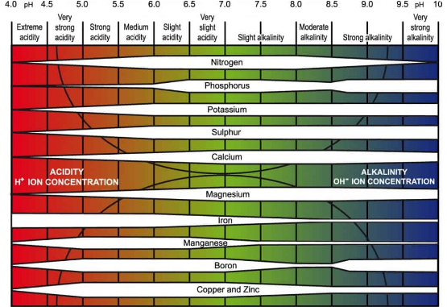

Why Measure pH?
The Master Variable.
pH controls nutrient availability. You can have plenty of Fertilizer in the soil, but if pH is wrong (acidic), the plant cannot "eat" it.
Ideal Range: 6.0 - 7.0

Slide 8



On-the-Go pH Sensing
How do we measure pH while driving a tractor?
1. Sampling
2. Contact
3. Measurement
4. Cleaning
Mechanical scoop grabs soil.
Brings soil to an electrode (ISE).
Reads Voltage (H+ ions).
Water jets wash the sensor.

Slide 9
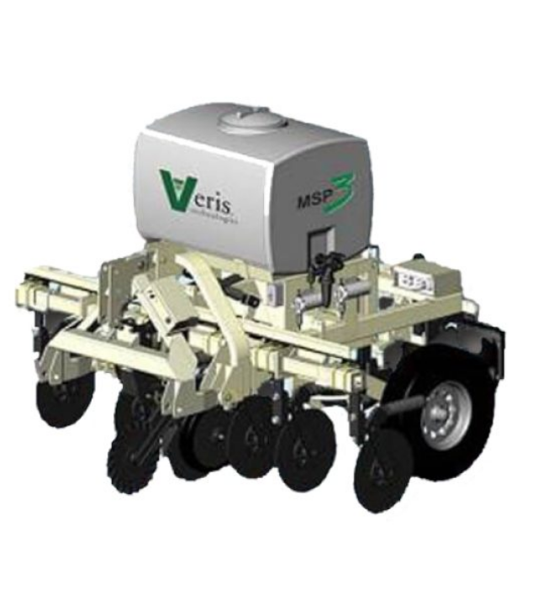
The Machine: Veris MSP3
The industry standard for on-the-go sensing.
MSP: Mobile Sensor Platform.
Measures: pH, EC, and Organic Matter simultaneously.
Speed: Can map 10-20 hectares per day.
Mechanism: Automated shoe takes a sample every few seconds.

Slide 10




Nutrient Sensing (N, P, K)
Measuring Nitrogen, Phosphorus, and Potassium is the "Holy Grail". Current technologies are emerging:
Optical
Electrochemical
Radiometric
Vis-NIR Spectroscopy
Ion Selective Electrodes
Gamma Ray Spectroscopy

Slide 11
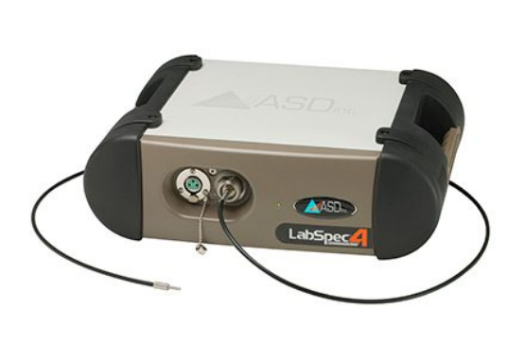
Optical Sensors (Vis-NIR)
Reflectance Spectroscopy
Light interacts with chemical bonds in the soil.
Concept: Shine a light -> Measure reflection.
Darker Soil: Often correlates with High Organic Matter (OM) and Carbon.
NIR Bands: Correlate with Moisture and Total Nitrogen.

Slide 12


The "Fingerprint"
Vis-NIR creates a spectral curve for the soil.
Carbon
Nitrogen
P & K
Strong absorption features in NIR. Very reliable.
Correlates with Carbon (OM). Good estimation.
No direct spectral feature. Poor accuracy with optical sensors.

Slide 13


Electrochemical (ISE)
Ion Selective Electrodes
Like a pH meter, but for Nitrate ($NO_3$) or Potassium ($K$).
Pros: Measures the actual nutrient ion.
Lab-on-a-chip Concept
Cons: Fragile membranes. Need frequent calibration. Drift issues.
Status: Still mostly in "Mobile Labs" rather than rugged field sensors.

Slide 14
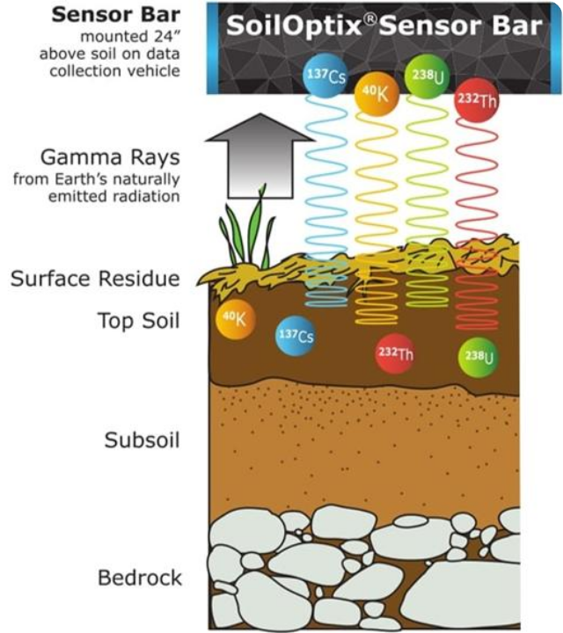
Gamma Ray Spectroscopy
The Passive Sensor.
Soil naturally emits low-level gamma radiation from radio-isotopes:
Potassium ($^{40}K$)
Thorium ($^{232}Th$)
Uranium ($^{238}U$)
This sensor simply "listens" to the soil radiation.

Slide 15



Gamma Ray Applications
What can radiation tell us?
Texture Mapping
Potassium
Weathering
Isotopes bind to Clay particles. High Radiation = High Clay Content.
Directly measures $^{40}K$, which correlates with total soil Potassium.
Thorium/Uranium ratios indicate soil age and parent material.

Slide 16
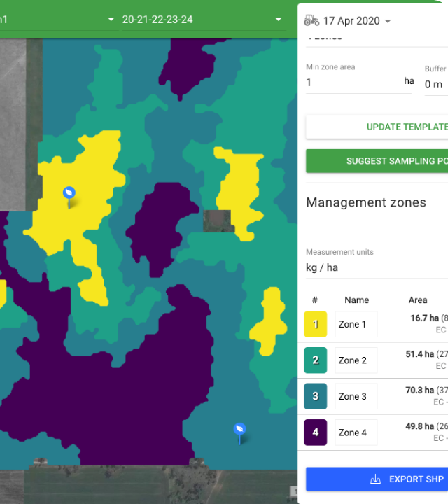
Application: VRA Lime
Using pH maps to fix acidity.
Uniform App: Wasteful. Over-liming neutral areas, under-liming acidic spots.
VRA: Apply lime only where pH < 6.0.
Benefit: Saves money and maximizes nutrient availability (P is locked up in acid soils).

Slide 17

Application: P & K Management
Using Gamma Ray or Grid Sampling data.
We generate a Prescription Map.
Red Zones (Low K): High Application Rate.
Green Zones (High K): Zero Application.
Result: Balanced soil fertility.

Slide 18

Lecture Summary
pH
Nutrients
Sampling
The "Master Variable". Measured by Veris MSP (ISE electrodes) on-the-go.
Vis-NIR (Optical) for Carbon/Nitrogen. Gamma Ray (Passive) for Texture/Potassium.
Sensors are great, but Lab Analysis (Ground Truth) is still required for calibration.
Next Class: Lecture 6 - Proximal Crop Sensors

Slide 19

Questions?
Dr. Kadeghe Fue | AGE 418
Sokoine University of Agriculture

